Slide 1
Notes:
Abercrombie & Kent began with the idea of “shoot with a camera, not with a gun”.
We believe that sustainable, nature-based tourism offers the best hope of protecting endangered places because it provides good jobs that reward local people for protecting wildlife, while preserving traditional cultures.

Slide 2
It began with a Commitment
Notes:
The foundation of Abercrombie & Kent’s business model is working in partnership with local communities to protect and preserve the culture, wildlife and ecosystem. When our guests see this commitment during their travels with us, they are often inspired to give back.
In Kenya, the Masai Mara Conservation Programme formalized A&K’s ongoing collaboration with local Maasai communities in planning their own development and enterprise priorities, building their capacity to manage natural resources and utilize the amazing biodiversity that draws visitors from around the world as a renewable, sustainable resource for their benefit. AKP programs include:
building classrooms
sponsoring school fees
introducing Maasai children to their natural heritage with field trips into the Masai Mara National Reserve
reforestation
micro-enterprise initiatives with women’s groups

Slide 3
Continuing the Legacy
Notes:
Sarah will introduce herself and explain her role with AKP and Sanctuary

Slide 4
Notes:
How Family Travel Can Make a Difference
We encourage families travelling with us to incorporate community visits and philanthropy into their safari.

Slide 5
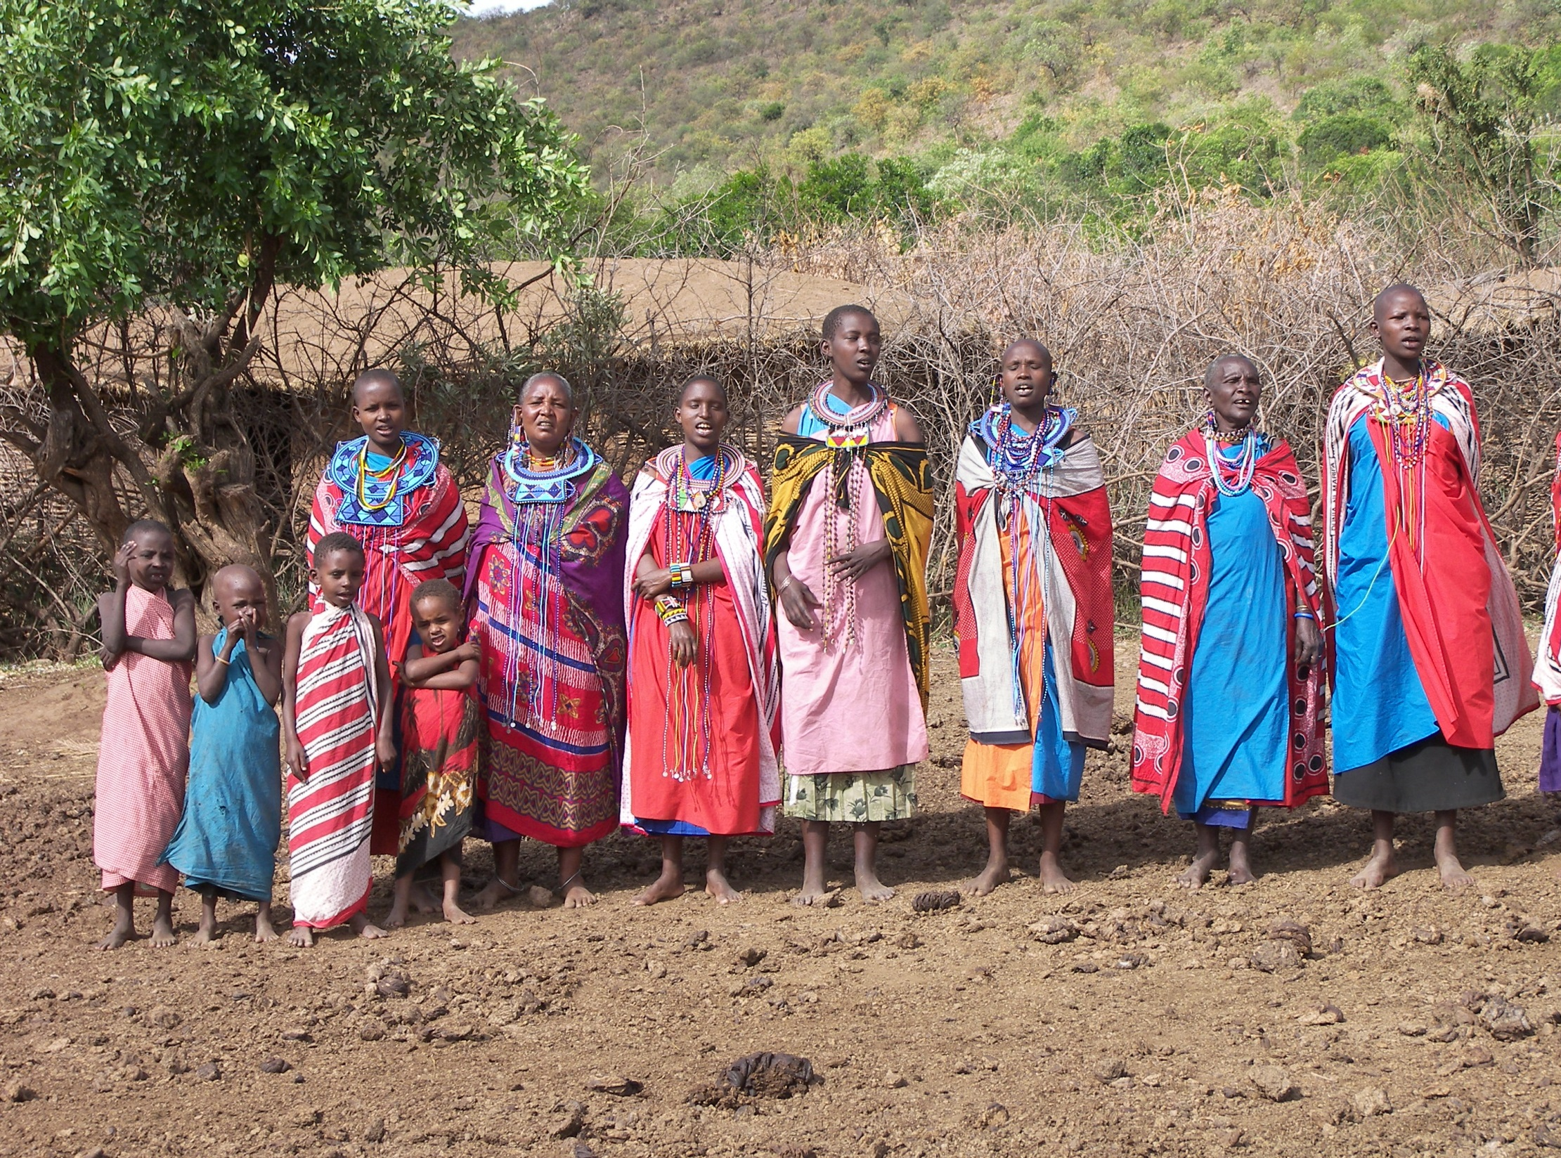
OBJECTIVE: Empower the “voiceless”

Slide 6
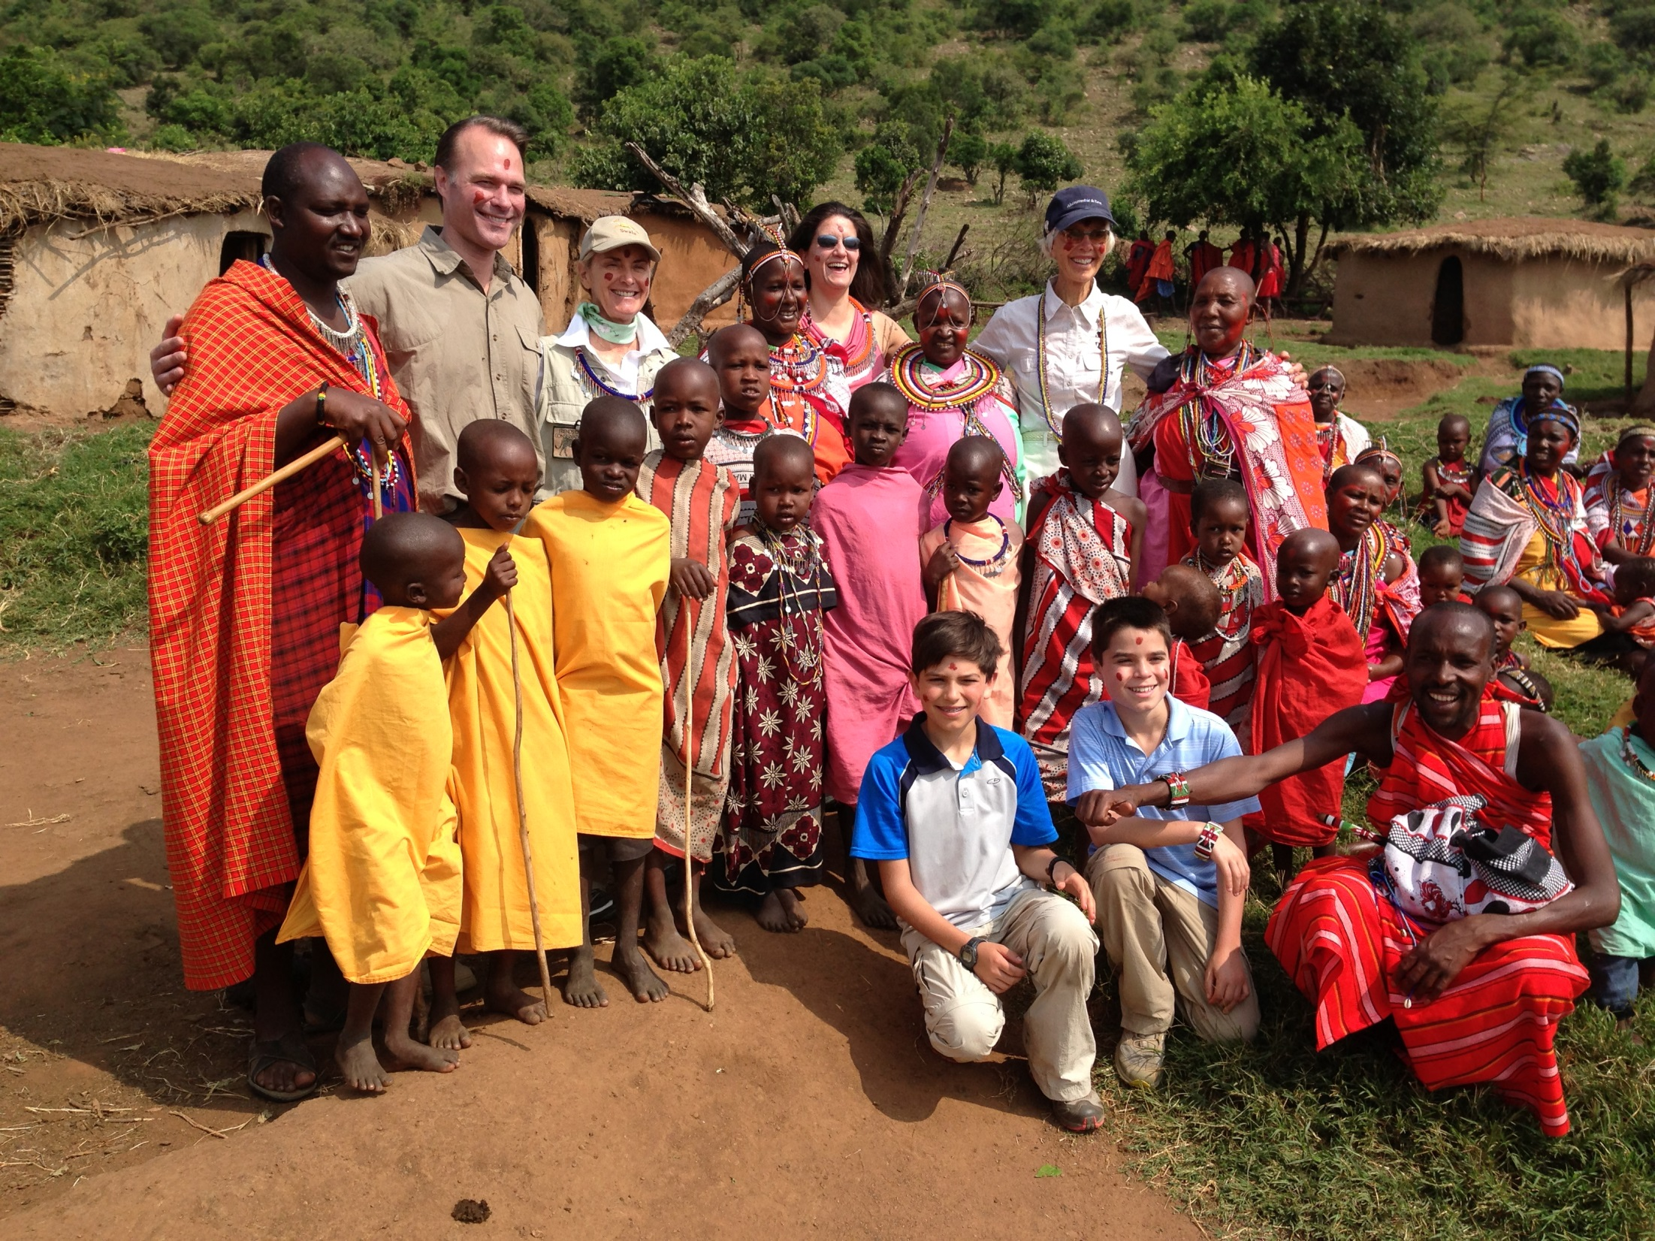

Slide 7
Education

Slide 8
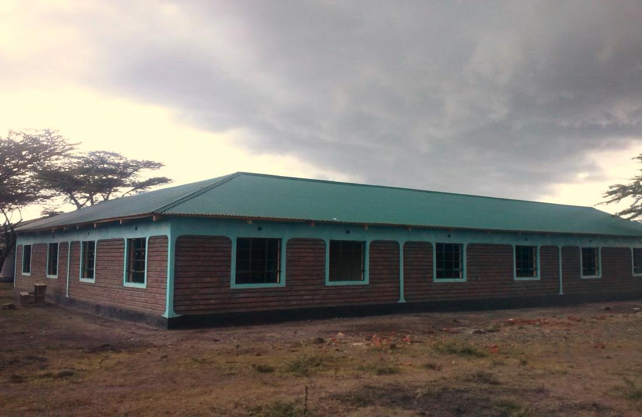
Enkereri Shool
Notes:
Enkereri School. AKPs commitment to build
Classroom blocks 5,6,7,8
Vegetable Garden

Slide 9
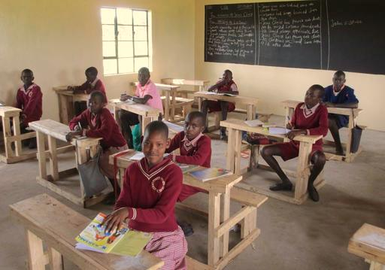

Slide 10
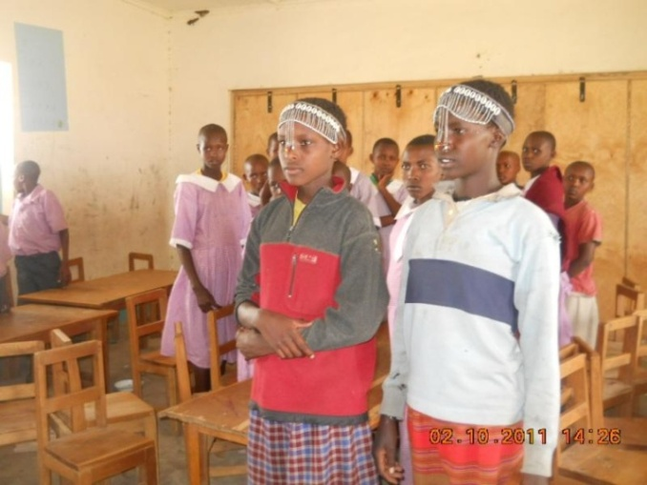

Slide 11
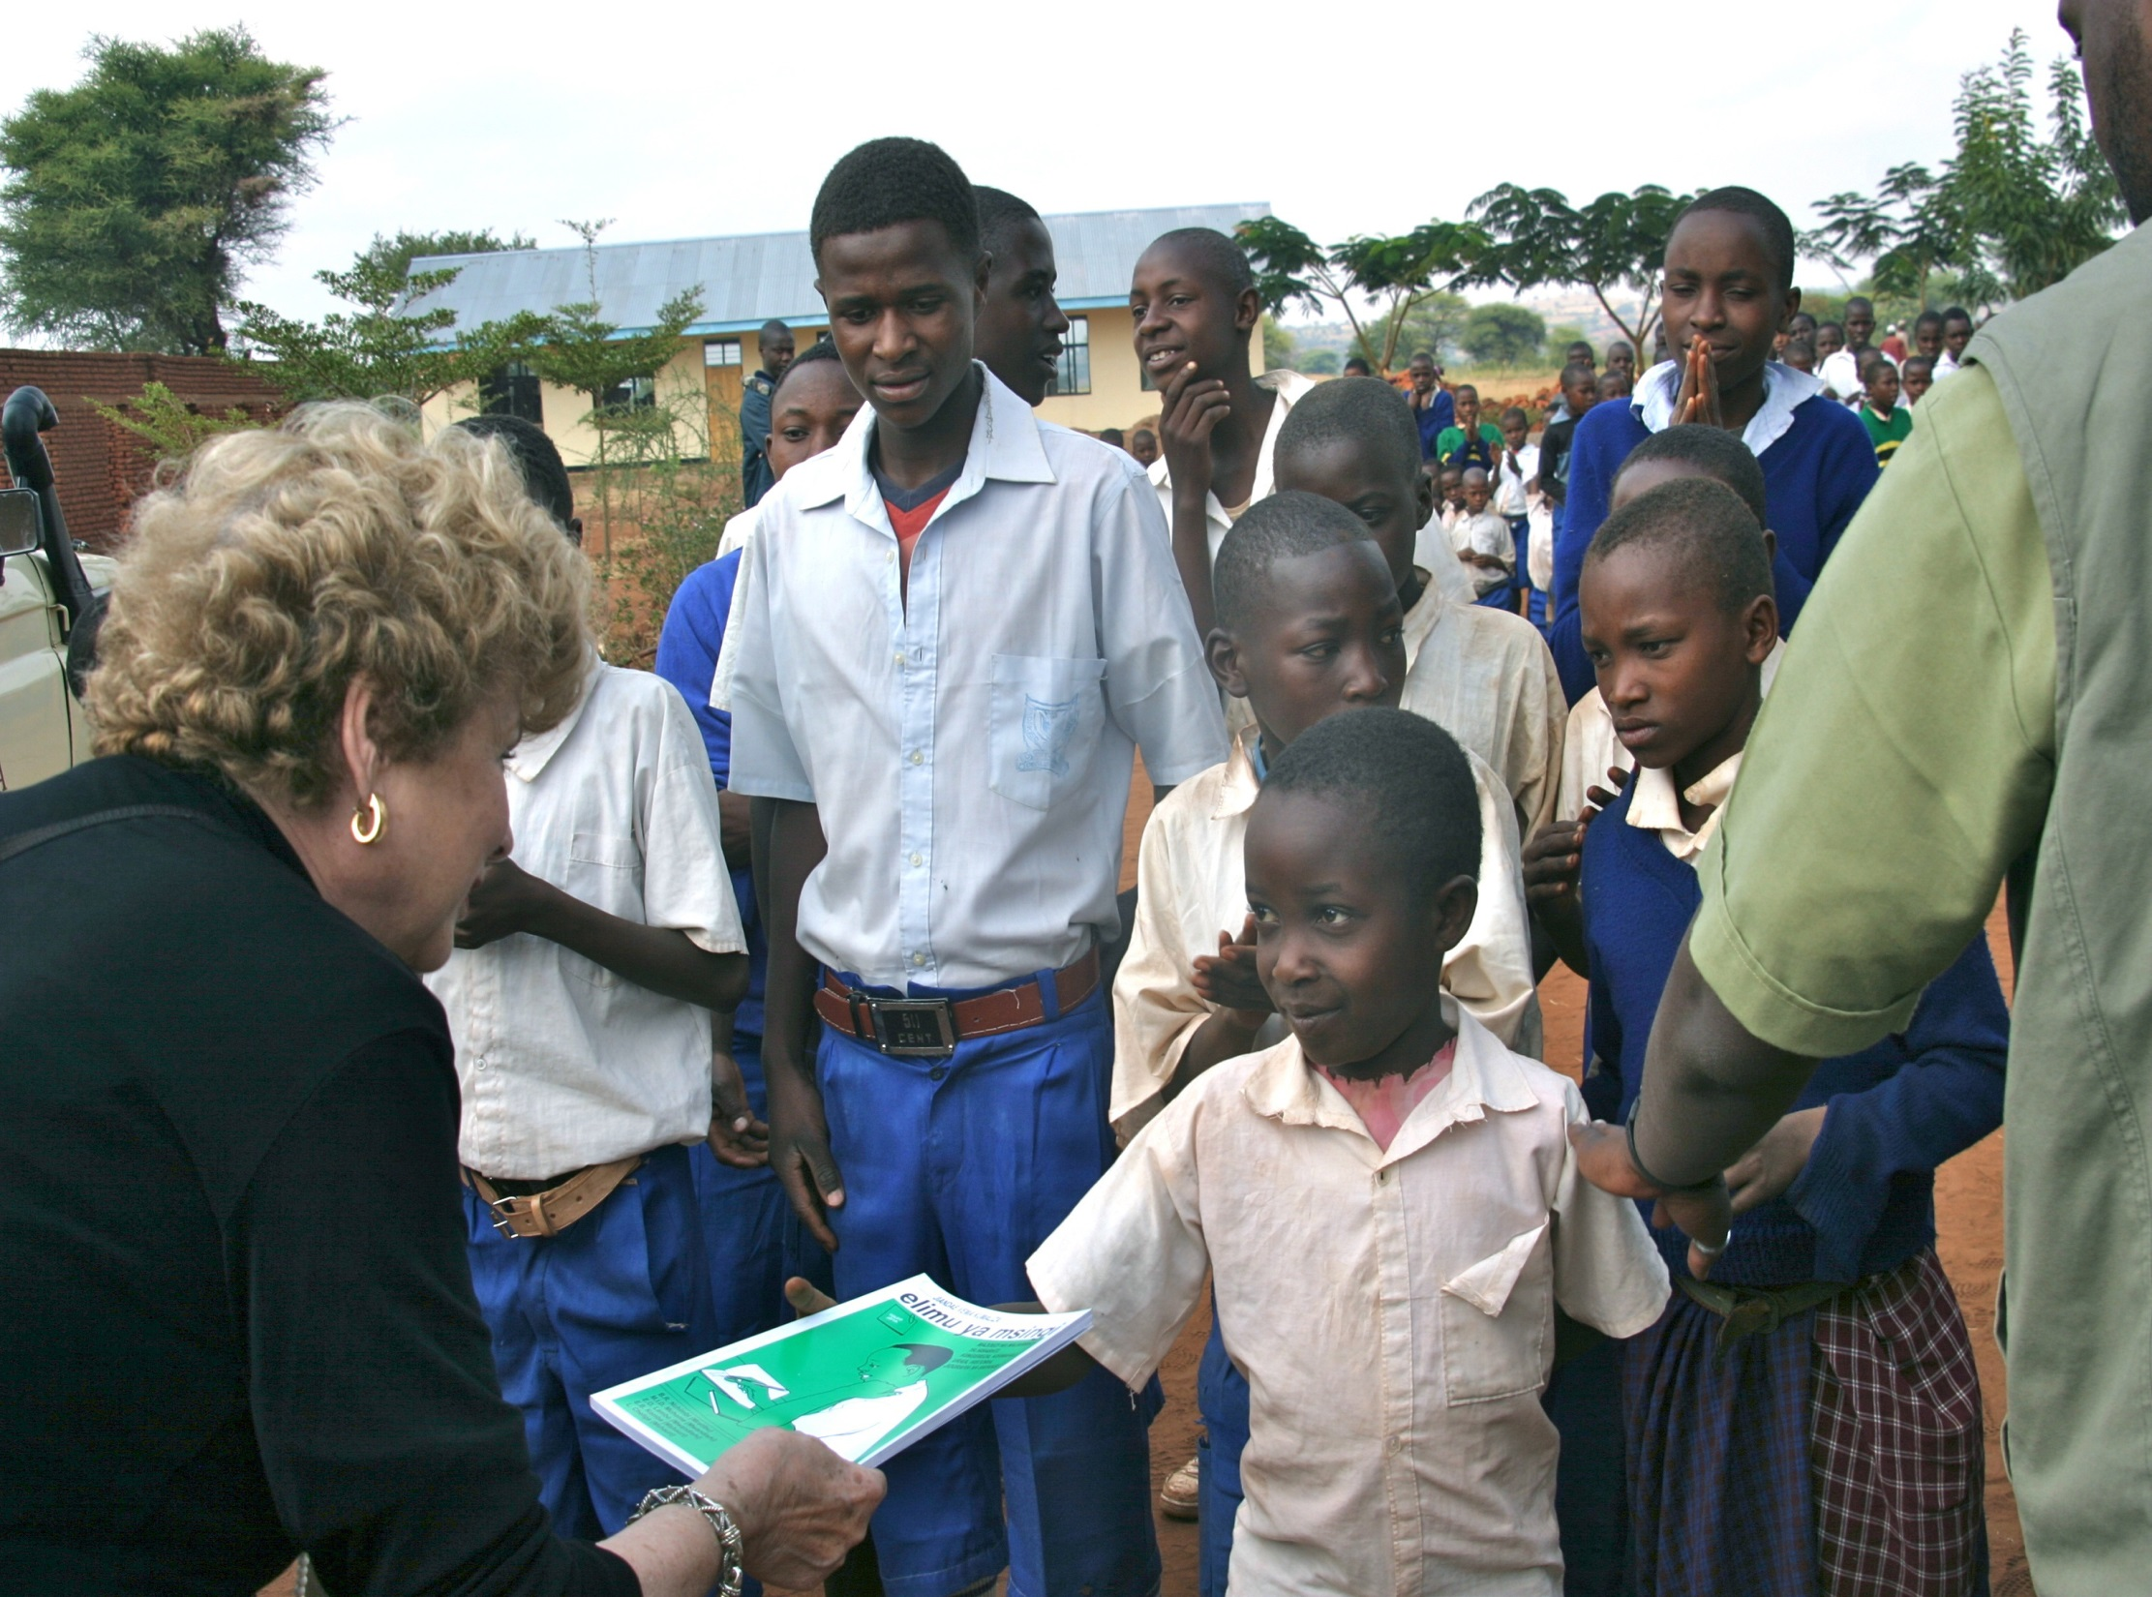

Slide 12
Impact from eReaders
2x
50%
24
Increase in reading comprehension in both English and mother tongue
Increase amongst students in measures of oral reading fluency
More words per minute read by students in English
Notes:
In the first 18 months of implementation…
The implementation process
Coordinator training
School selection
Textbook selection
Visit schools with program in place
Build cabinets with chargers
Teacher training
Launch event at each school
Monitor student progress

Slide 13
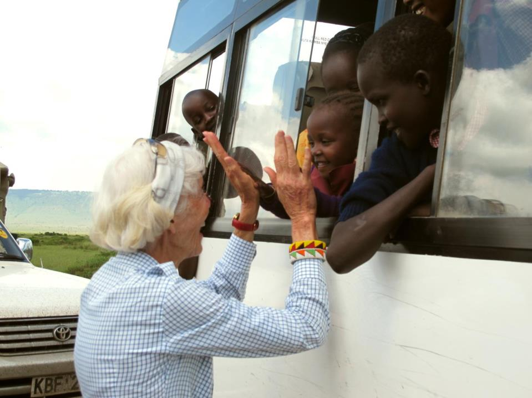
Field Trips
Notes:
Wildly popular with students, teachers and parents are the “Rhino Watch” field trips A&K sponsor which take Maasai children into the Reserve to enable them to experience their natural heritage just as international visitors do and better understand conservation and the many benefits of sustainable tourism. More than 1,500 have participated since A&K support launched the program.

Slide 14
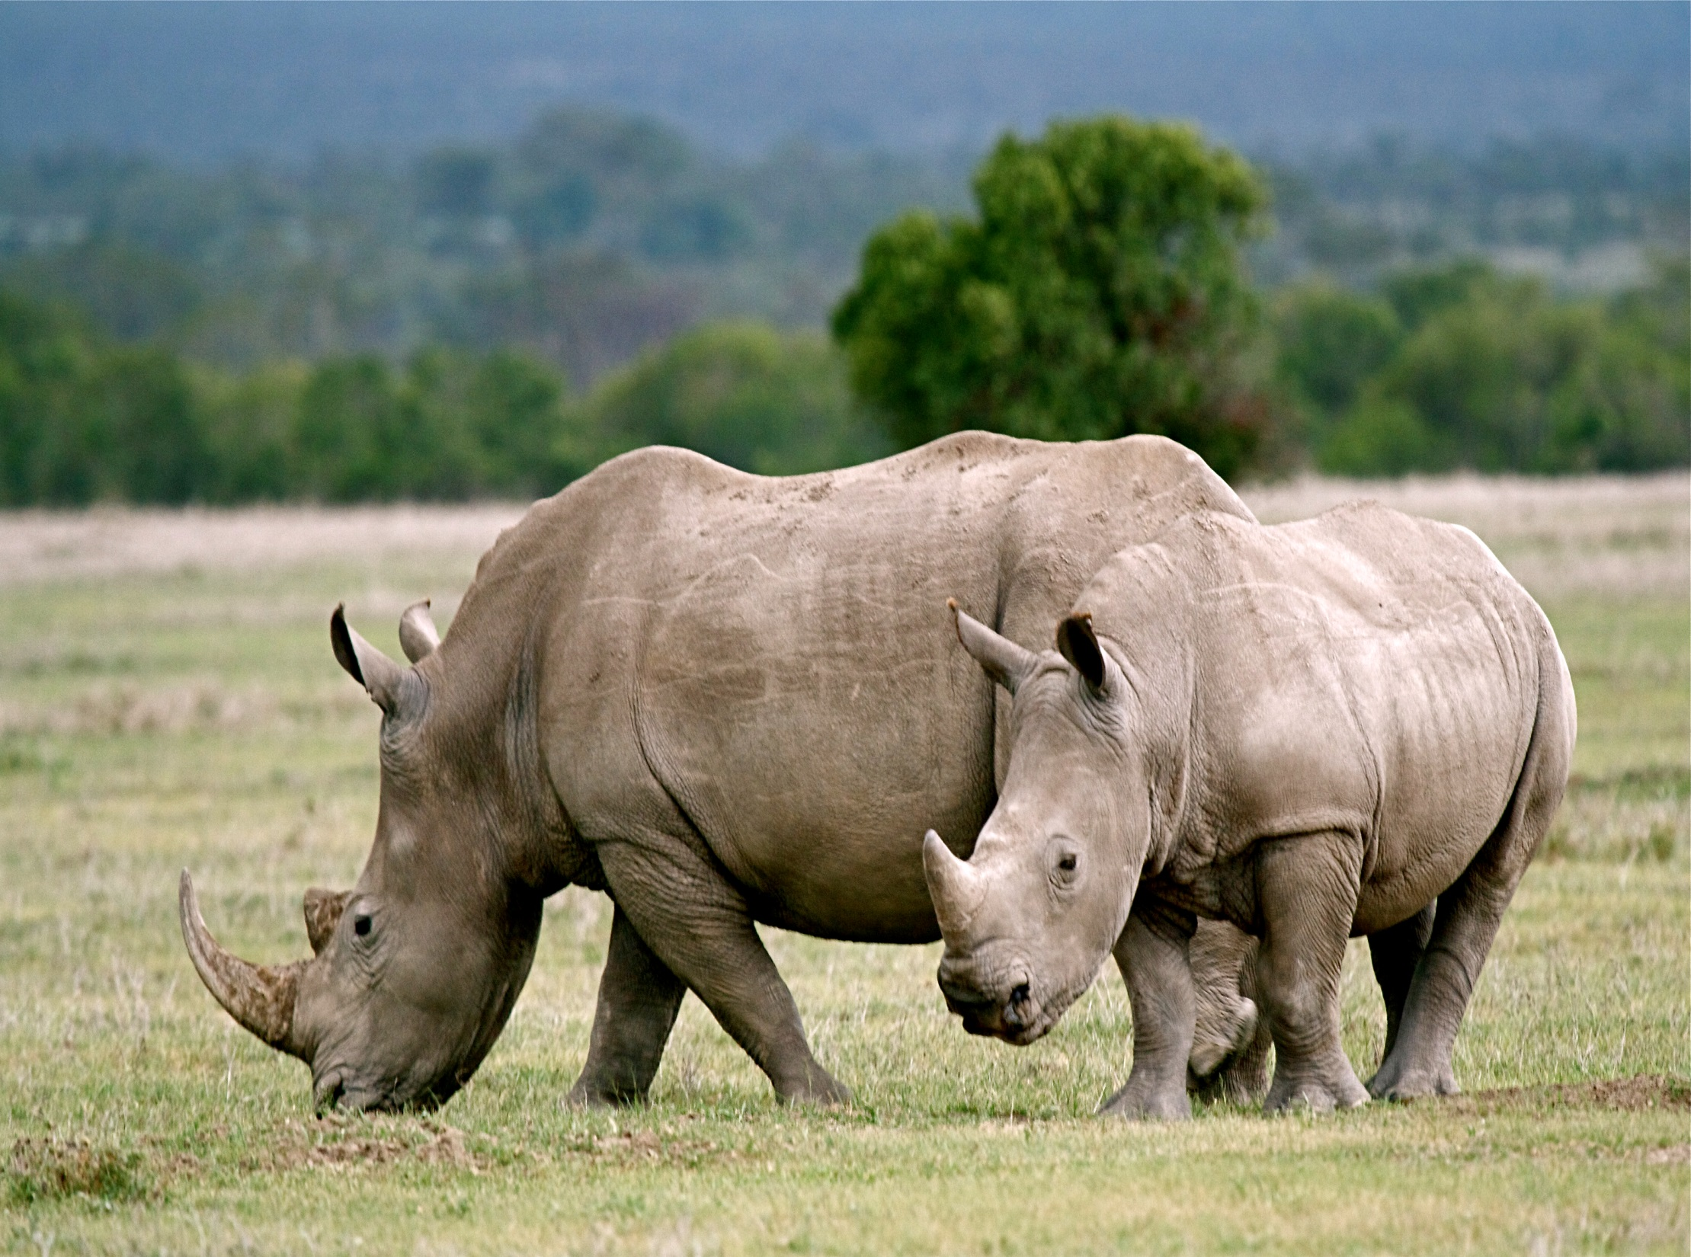

Slide 15
Conservation
Notes:
Second AKP pillar

Slide 16
Tree Planting & Reforestation
Notes:
Guests are invited to plant indigenous trees as a way to personally aid reforestation efforts in the Masai Mara. An organic garden recycles green vegetation from the wetlands as compost.

Slide 17
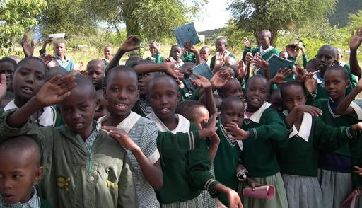
Notes:
Maasai children involved in Conservation Clubs are sharing with other students and their families and communities the importance of trees – to provide shade, serve as windbreaks, enrich the soil, and regulate water run off.

Slide 18
Enterprise

Slide 19
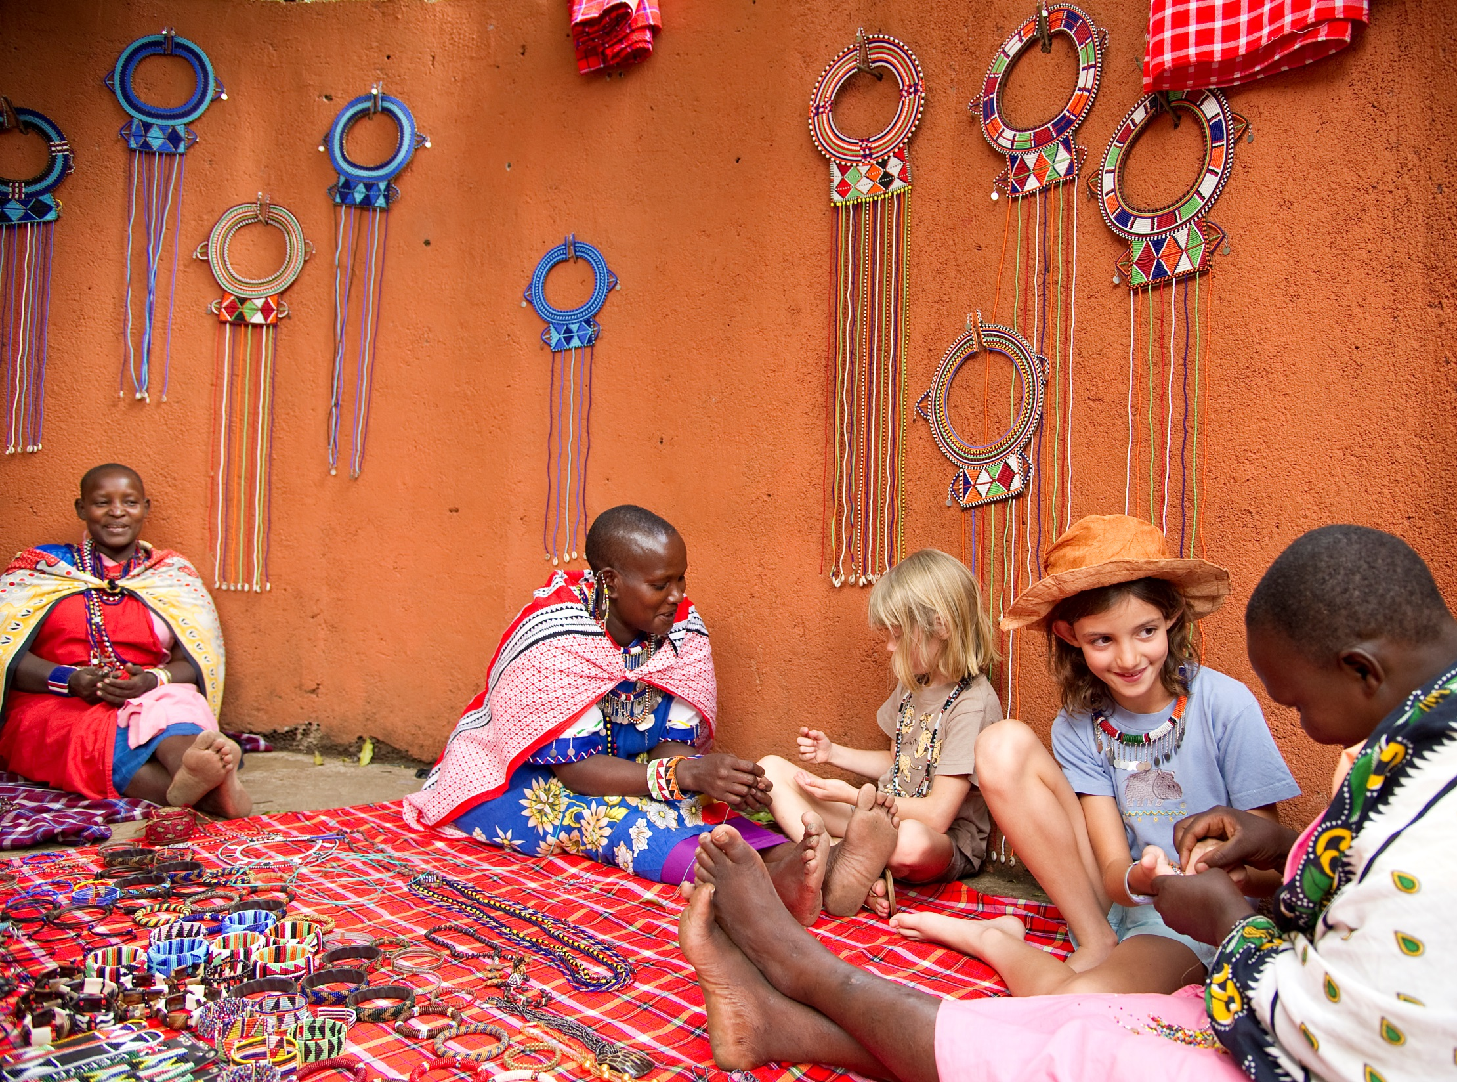
Women’s Beadwork Micro-Enterprise
Notes:
Guest can browse the beautiful traditional handiwork of the Olonana Maasai Women’s Beadwork Project supported by AKP and Santuary Olonana. Guests can see the women create their beadwork and purchase handicrafts in the gift shop. 100% of each purchase goes directly to the women’s group. This income helps meet the needs of their families and educate their children.

Slide 20
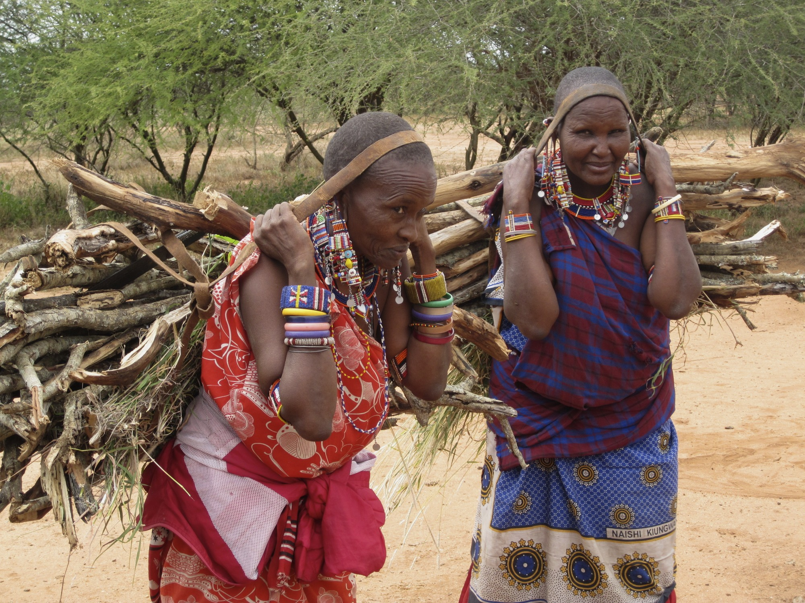

Slide 21
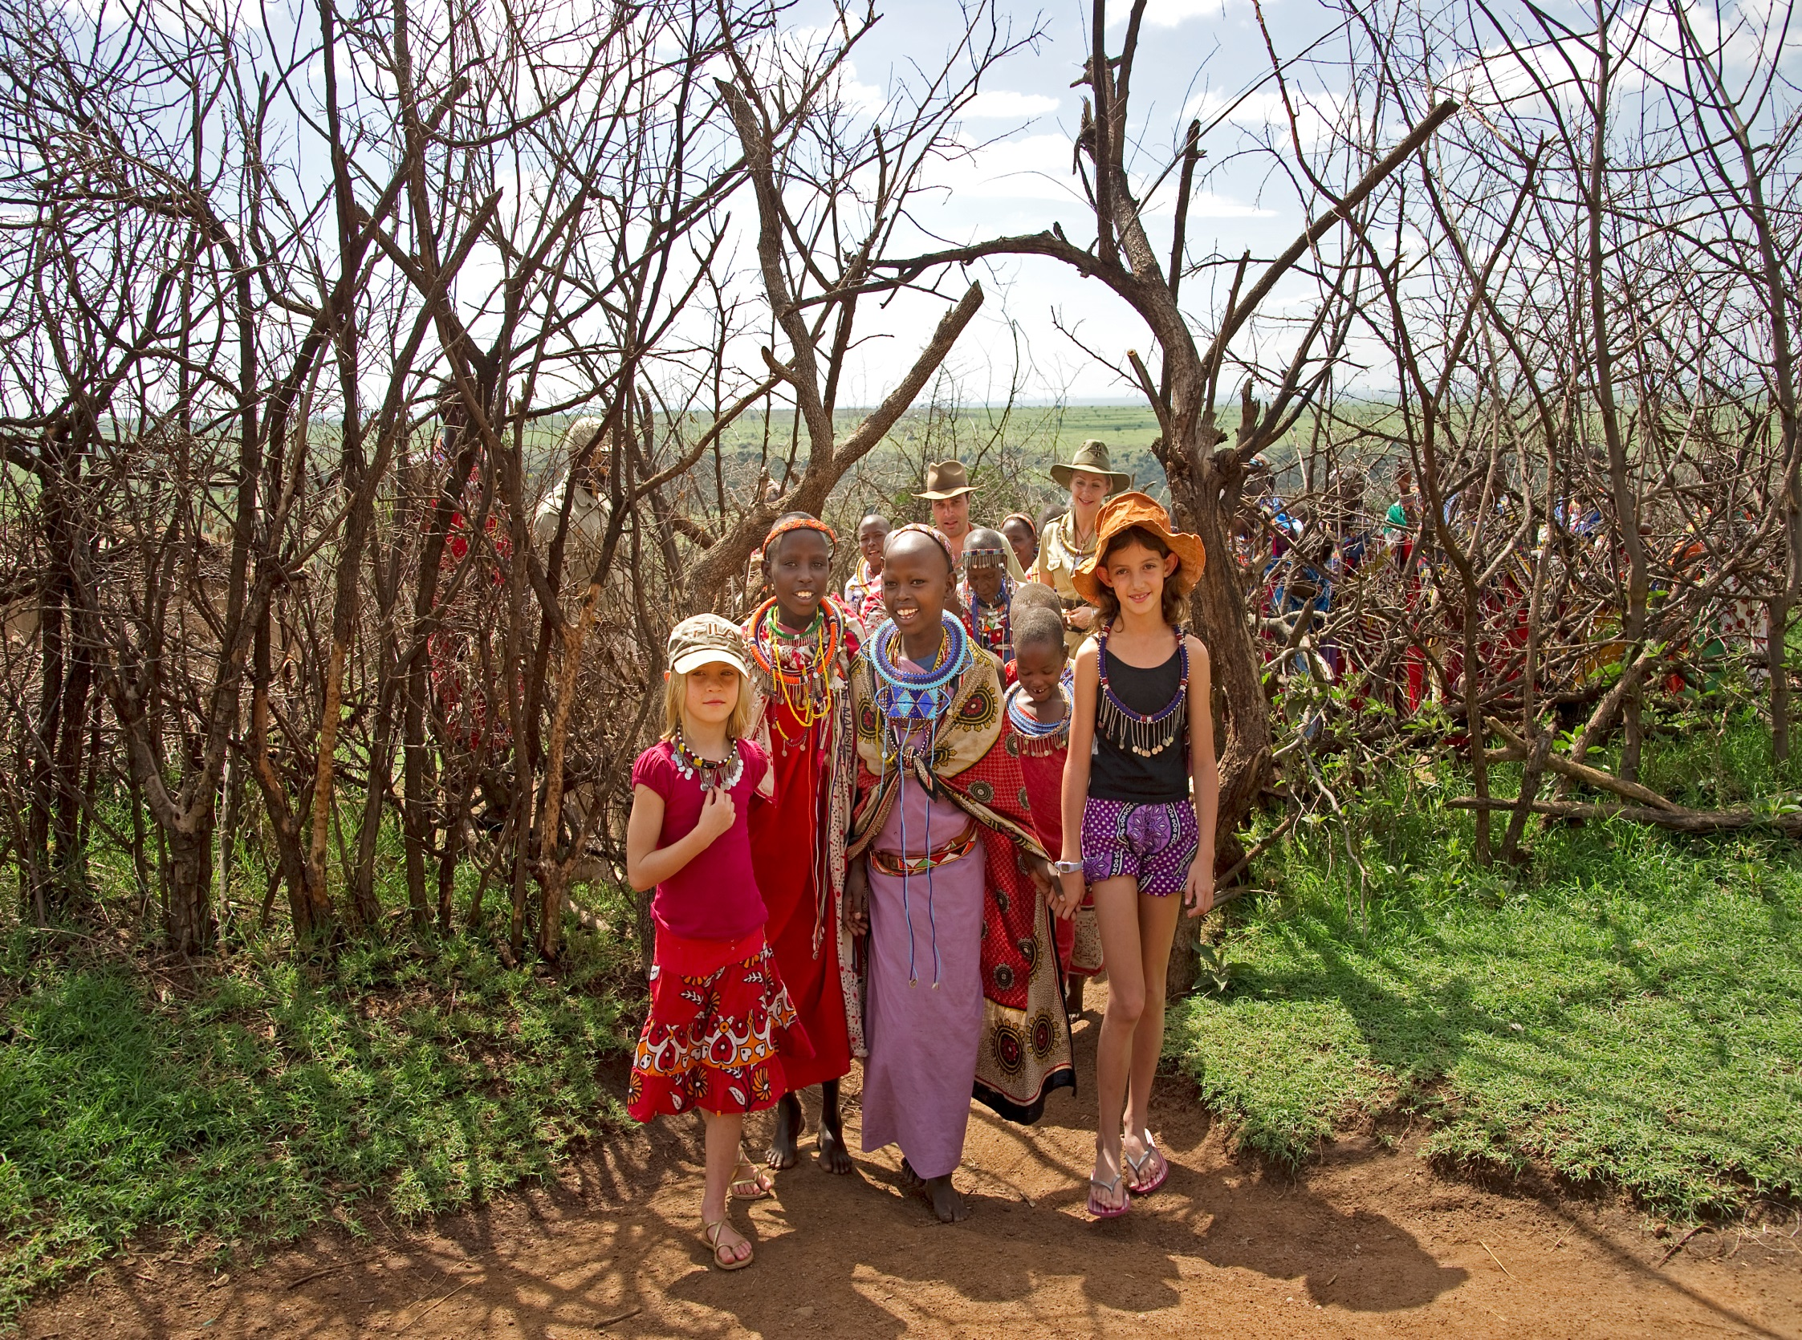

Slide 22
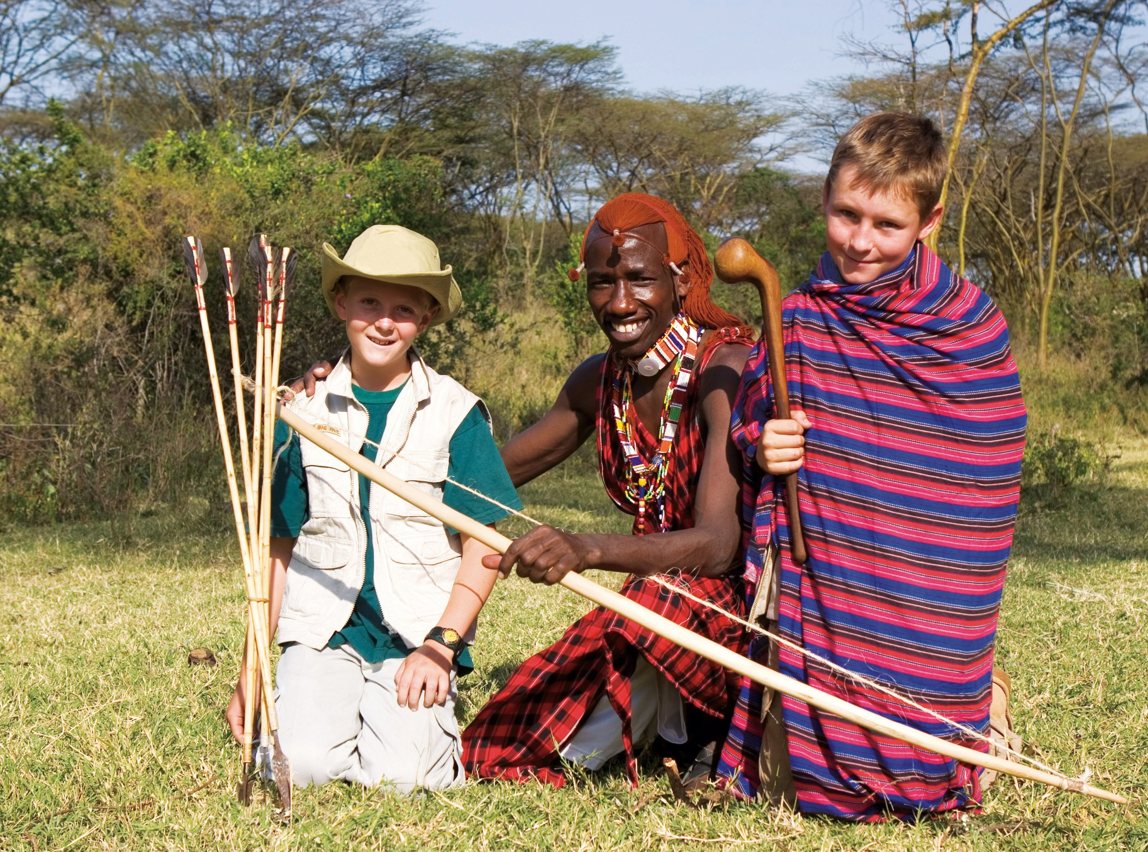

Slide 23
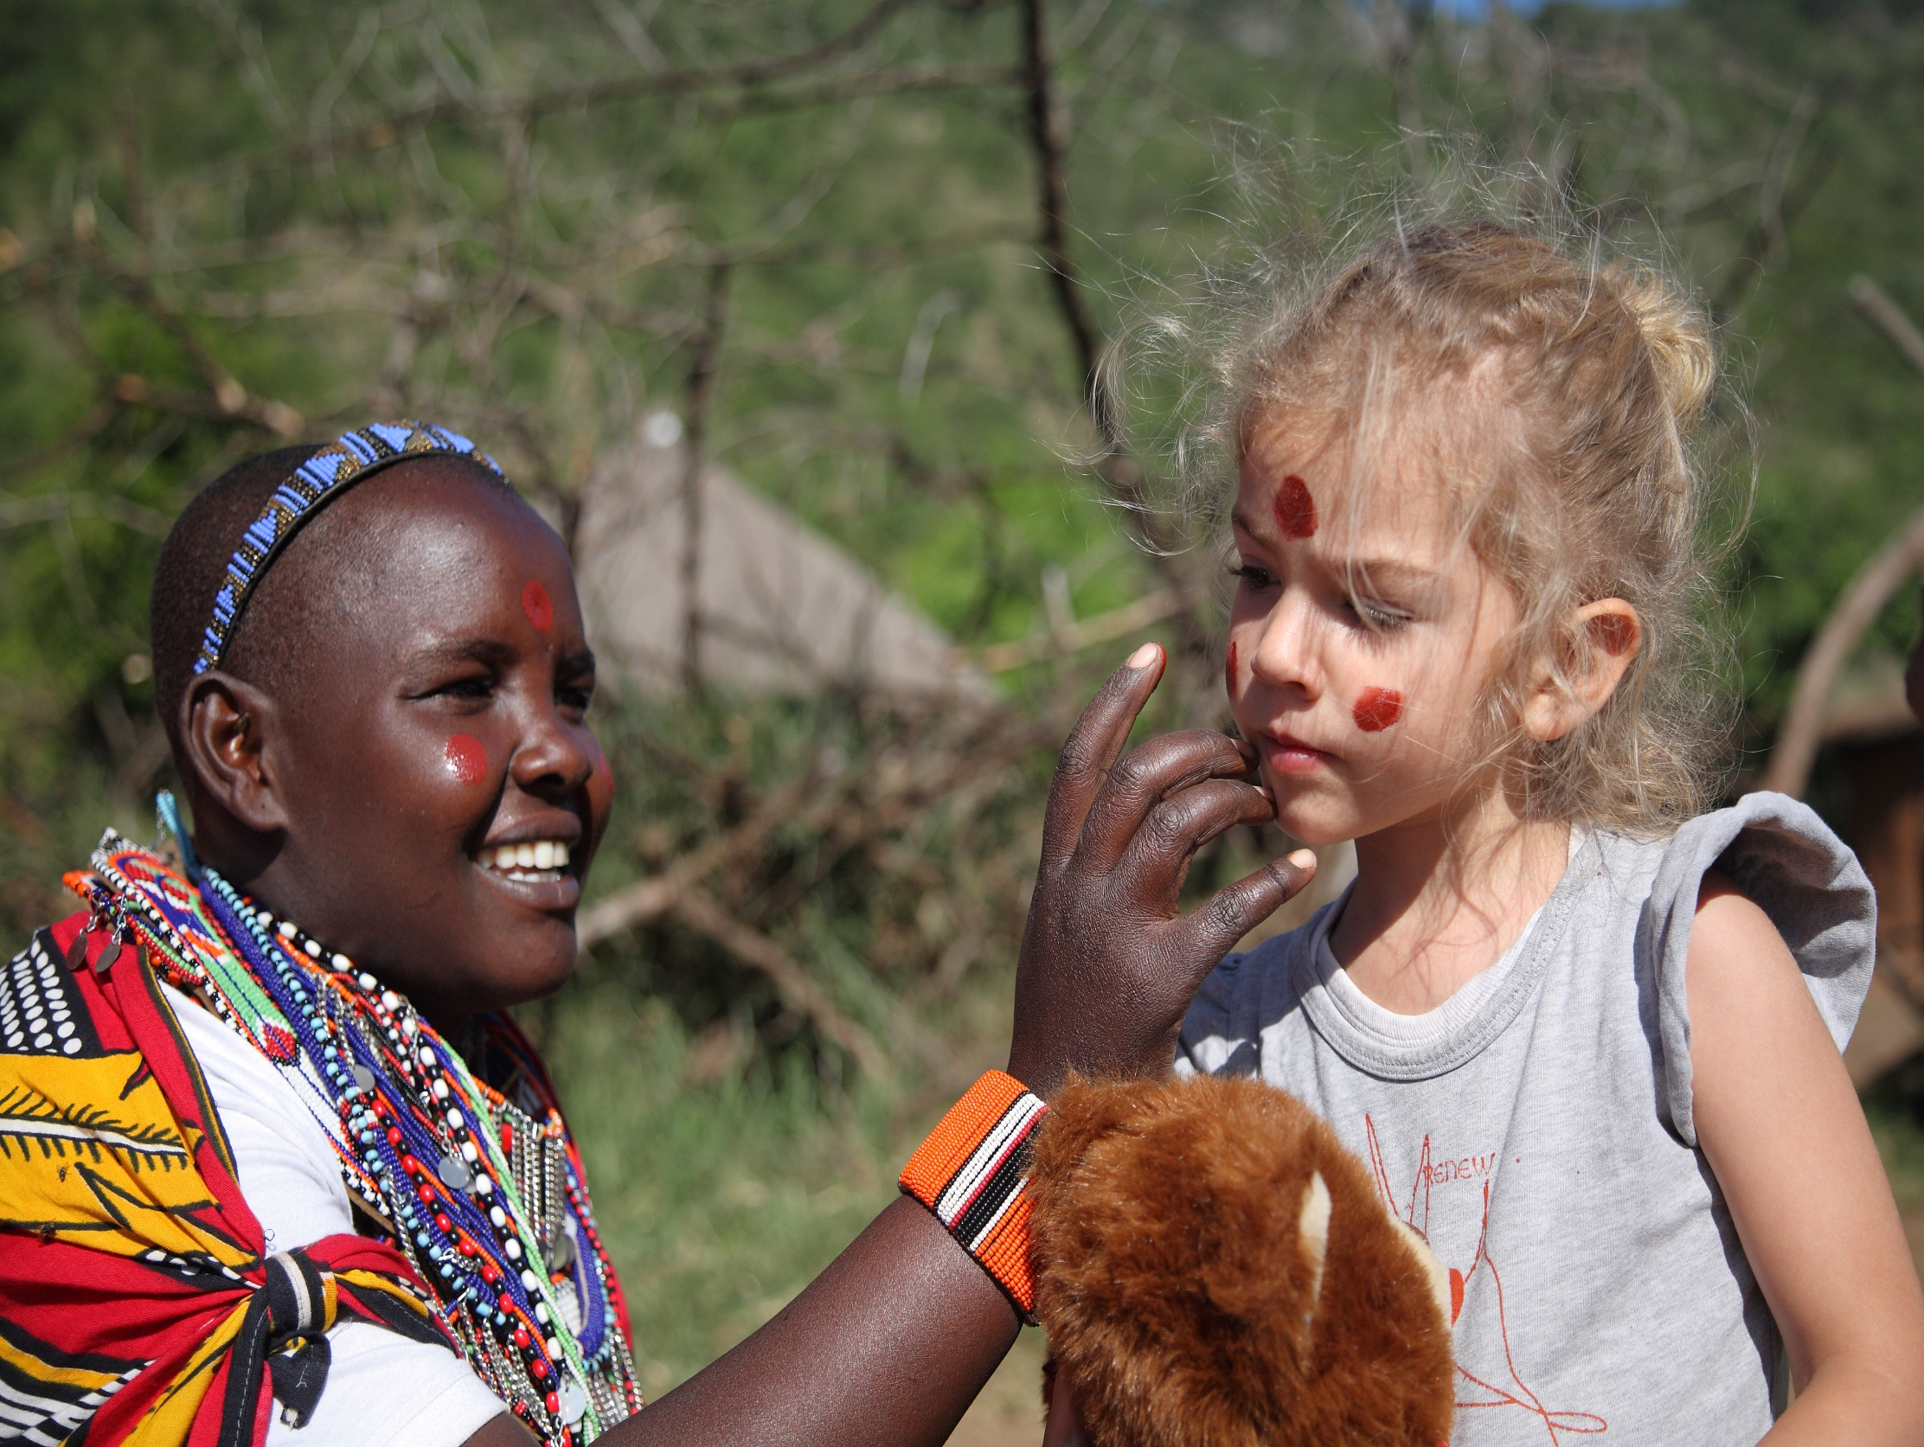

Slide 24
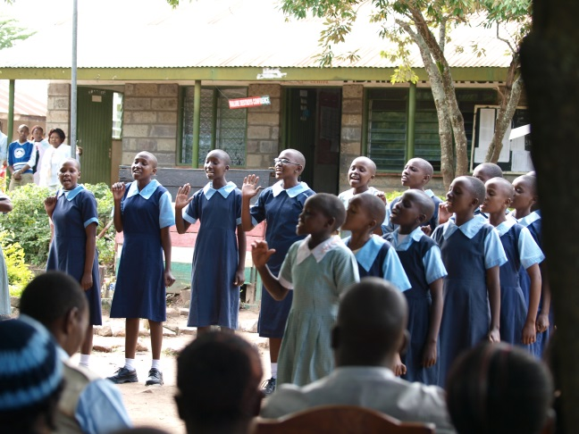
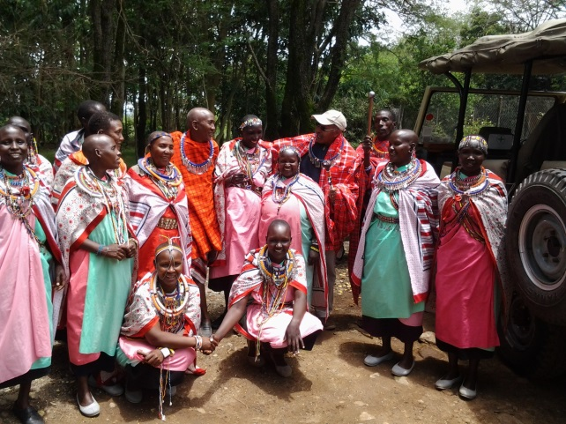
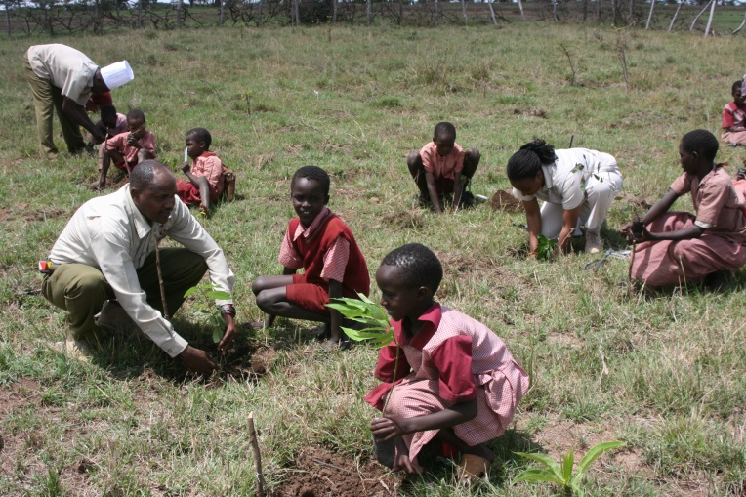
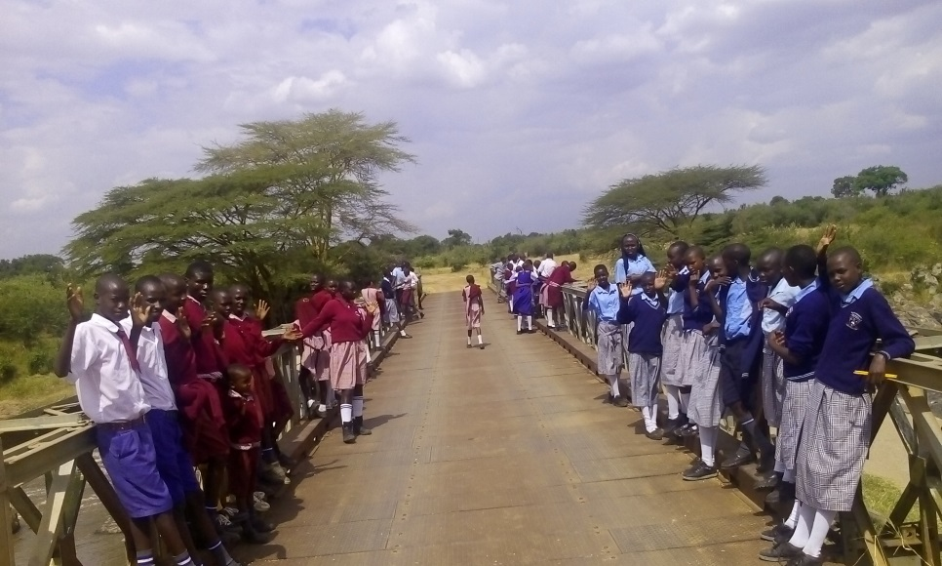
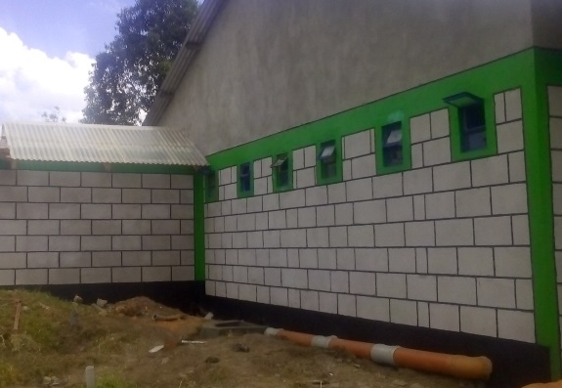
Success Stories
Notes:
Education sponsorship
Rhino Watch trips
Girls’ ablutions block
Tree planting
Community Empowerment

Slide 25
If you educate a woman, you build a nation
-Ashe Oleng

