Slide 1
How Technology Is Impacting Family Travel
Toby O’Rourke
Sr. Vice President, Marketing
Kampgrounds of America, Inc.
@toby_orourke
@KOAKampgrounds

Slide 2
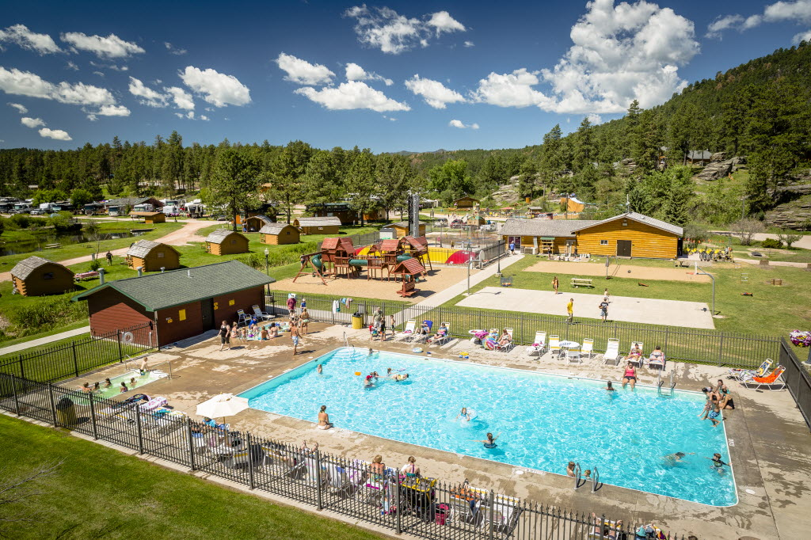

Slide 3
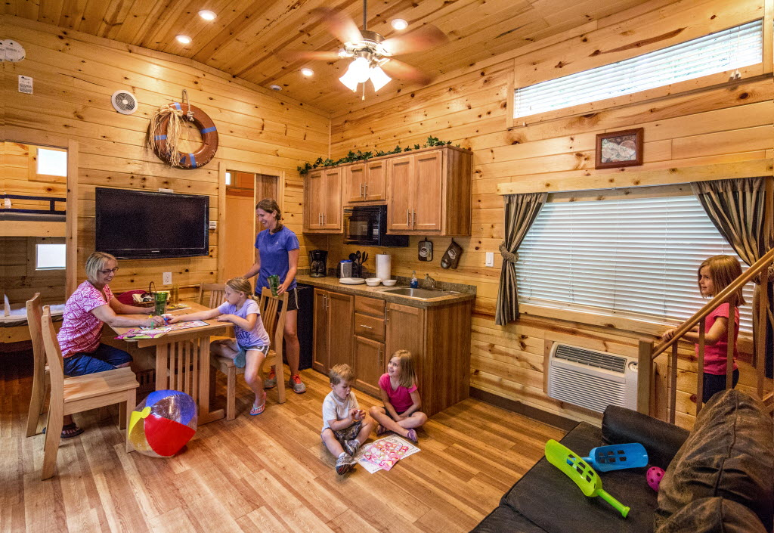

Slide 4
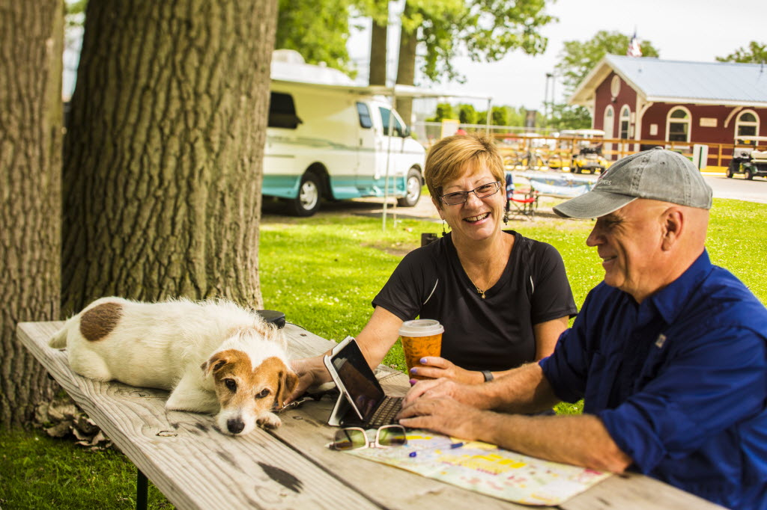

Slide 5
ACCESSIBLE

Slide 6
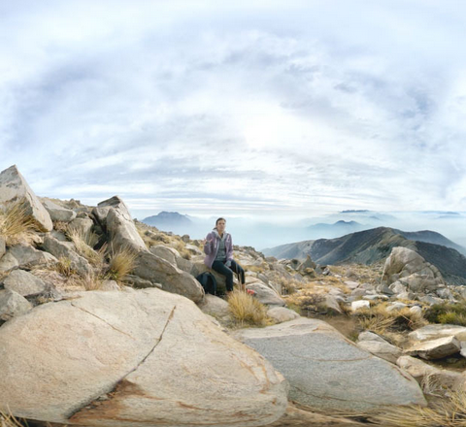

Slide 7
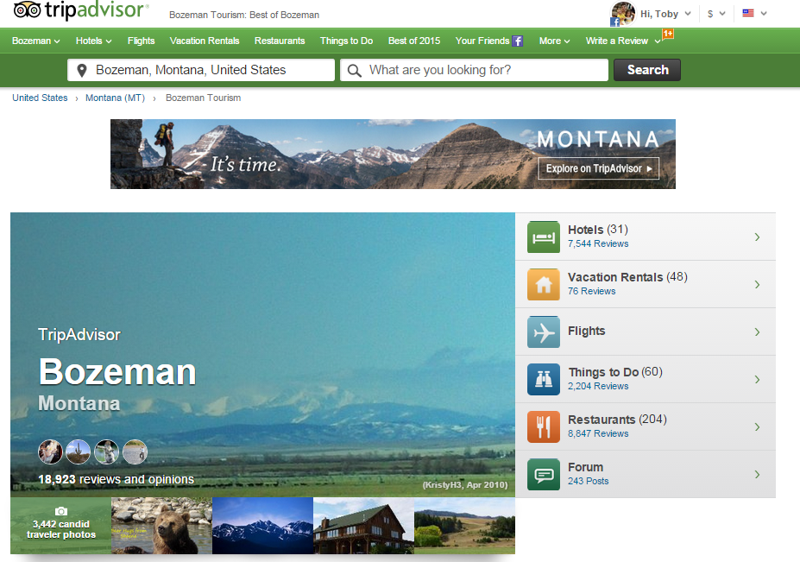

Slide 8
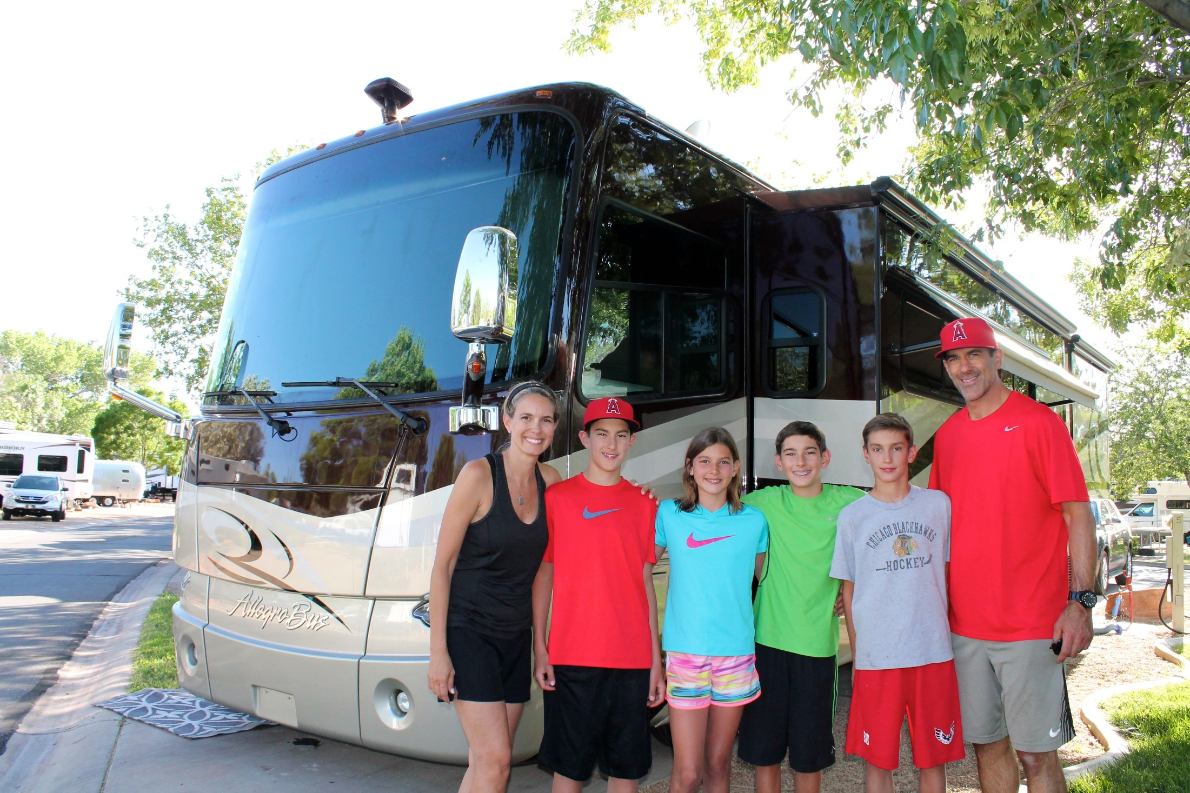

Slide 9
ENGAGES KIDS

Slide 10
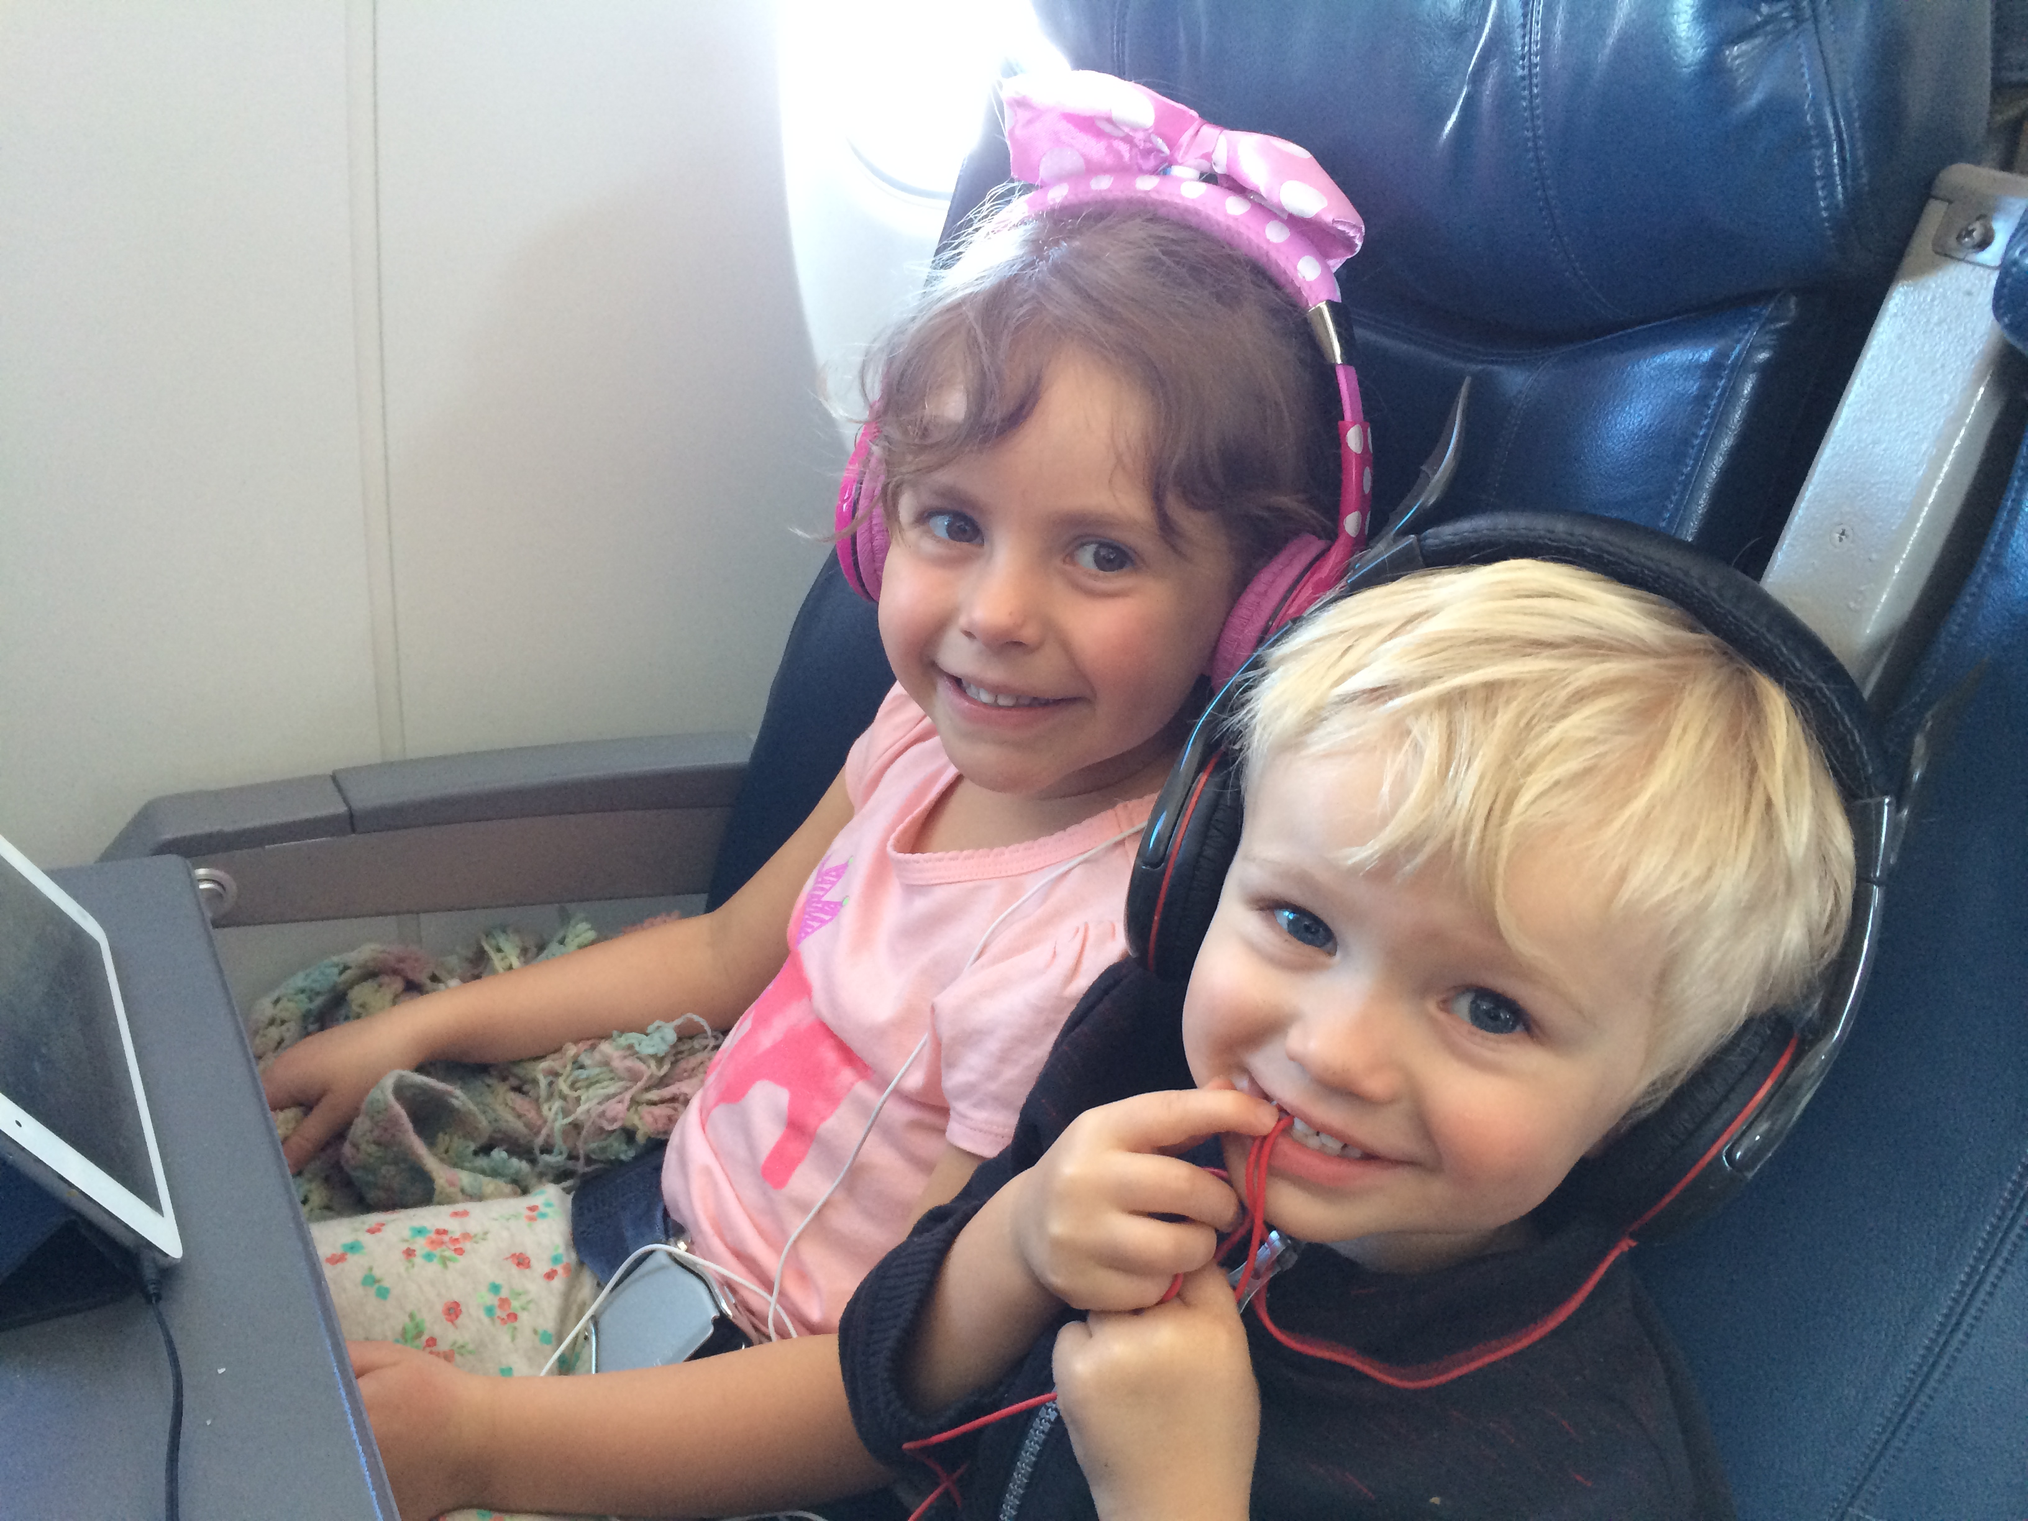

Slide 11
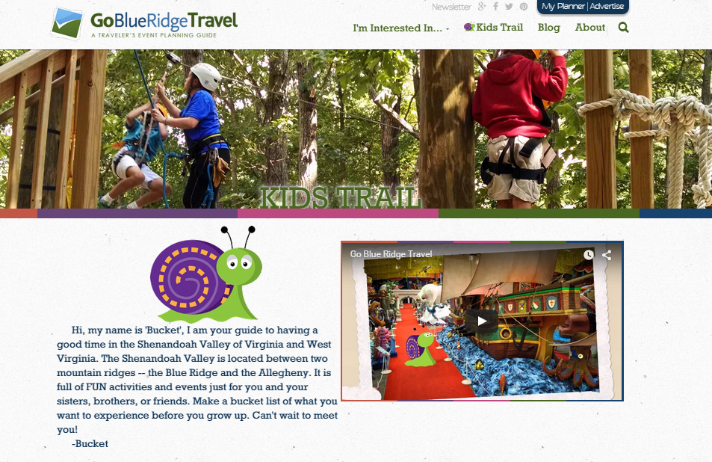

Slide 13
CONSTANT CONNECTION

Slide 14
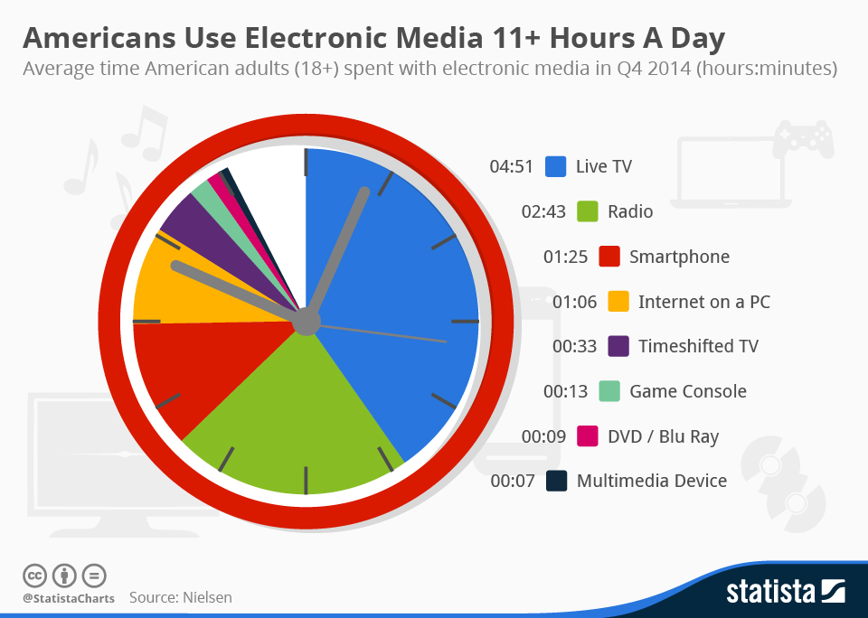

Slide 17
INSTANT

Slide 18
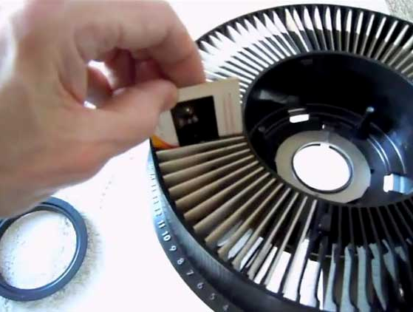
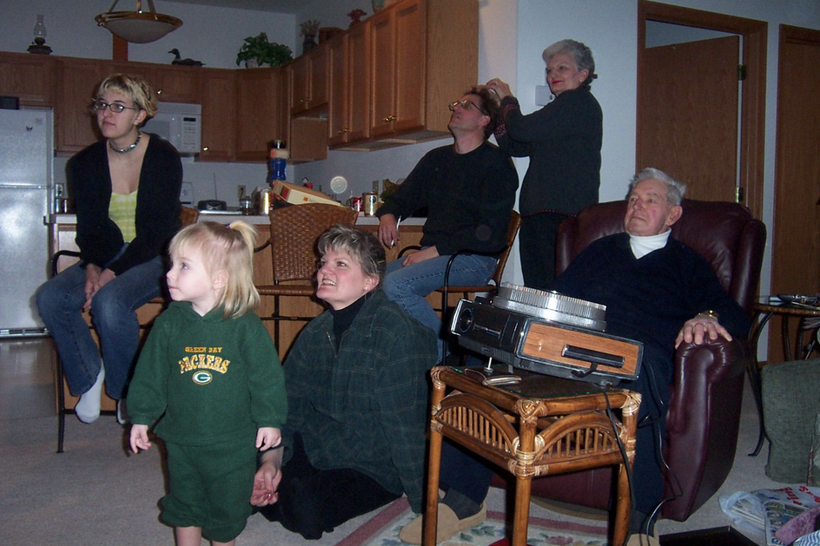

Slide 19
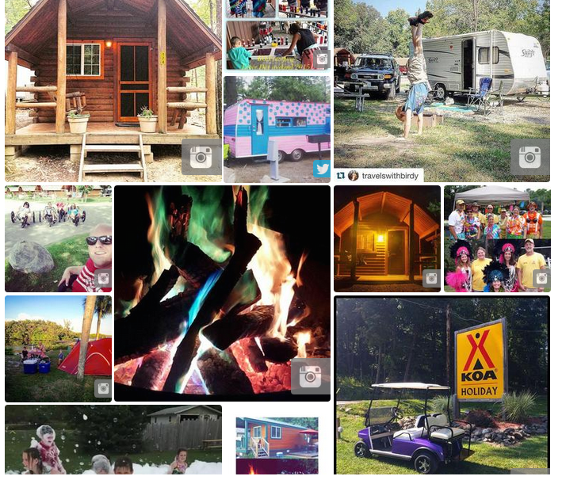
#KOACamping

Slide 20
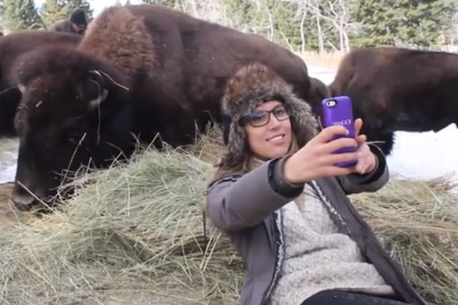

Slide 23
